Slide 1
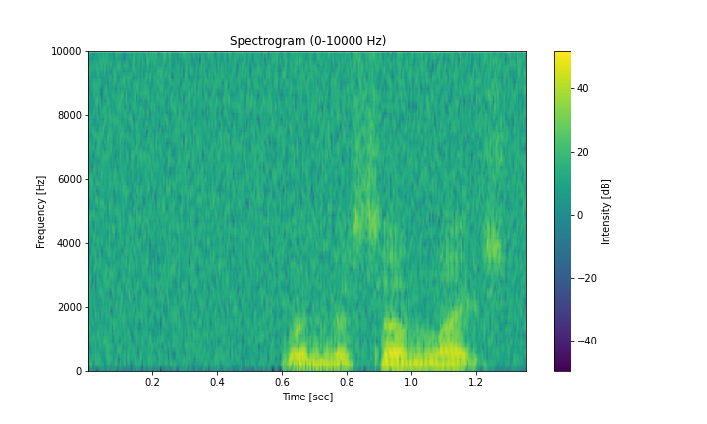
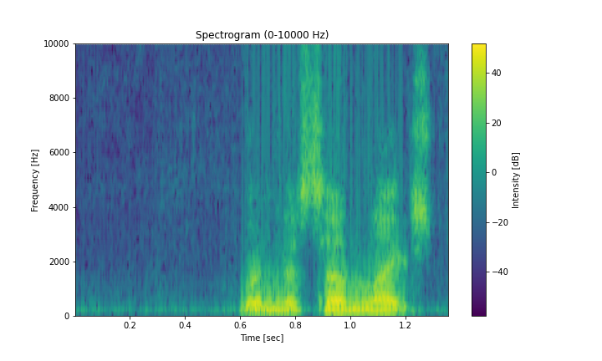
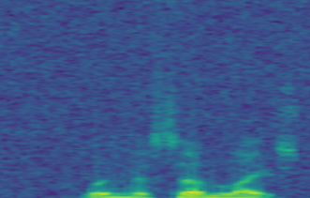
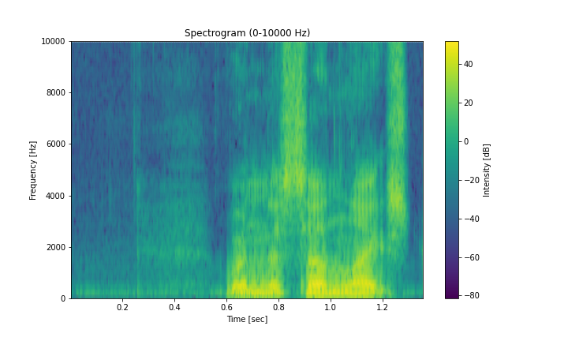
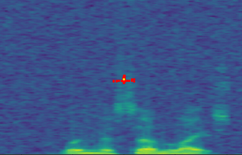
Reduction
Reduction
local attention
Conv 3x3
x₁
Codebook
Conv 3x3
e₁₁,...,e_{N1}
x₂
S
e₁₂,...,e_{N2}
Expansion
...
x₁
...
e₁₁,...,e_{N1}
FC
Expansion
x_{k}
x₂
S
e₁₂,...,e_{N2}
FC
Conv 3x3
Key
...
e_{1K},...,e_{NK}
...
Conv 3x3
x_{k}
Value
e_{1K},...,e_{NK}
BN-ReLU
Key
Value
BN-ReLU
GroupNorm
Reduction
=
Reduction
BatchNorm
GroupNorm
GroupNorm
BN-ReLU
Reduction
GroupNorm
Depthwise
Convolution
Conv5×5
Conv 3x3
Relu
BN-ReLU
Channel
MLP
Depthwise
Convolution
Conv5×5
Conv 3x3
Conv 3x3
Conv5×5
Channel
MLP
Channel
Scaling
BN-ReLU
Expansion
Mean
Conv5×5
Channel
Scaling
Channel
Scaling
Expansion
Expansion
BN-ReLU
Channel
Scaling
Conv 3x3
FC
Conv 3x3
FC
BN-ReLU
GroupNorm
GroupNorm
BN-ReLU
GroupNorm
GroupNorm
local attention
Depthwise
Convolution
Channel
MLP
x₁
e₁₁,...,e_{N1}
Depthwise
Convolution
Channel
MLP
Feature Interaction
x₂
S
e₁₂,...,e_{N2}
Feature
Interaction
Channel
Scaling
Channel
Scaling
...
...
Channel
Scaling
Feature Interaction
Channel
Scaling
x_{k}
e_{1K},...,e_{NK}
Key
Value
Conv1×1
Conv5×5
Concat
Complex
GlobalScope MLP
GlobalScope
Dependencies Interaction
BN-ReLU
Local corner Interaction
Real Domain Feature Extraction Unit
Imaginary Domain Feature Extraction Unit
Scaling Factors
Context Boradcasting
Channel-wise Multiplication
Input Tokens X
Avg
Broadcasting
Element-wise Addition
Context Broadcasting(CB)
y
Features from x
Features from y
Features from 3x3
Features from y
Features from x
Features from y
Features from 1x1
Features from 3x3
Features from y
Features Maps
x
3×3conv
Features from x
Features from x
Features from 1x1
DSConv
y
x
3×3conv
Features from y
Features from x
Features from y
Features from 1x1
Features from x
Features from 3x3
Channel 1
Input Noise(a)
Features Maps
Channel 1
Features from y
DSConv
Features from y
Features from 1x1
K_{j+4}
Features from x
Features from 3x3
Features from x
tubular
structure
K_{j+2}
K_{j+3}
K_{i-4}
K_{i-3}
K_{i-2}
K_{j+1}
K_{i+1}
K_{i+2}
Chennel 2
K_{ij}
K_{i+4}
Chennel 2
K_{i-1}
K_{j-1}
K_{i+3}
Features from y
Features from 3x3
K_{j-2}
Features from x
Features from y
Clean(b)
SE
K_{j-3}
Features from y
Features from x
Features from 3x3
GN
K_{j-4}
Features from y
Features from y
Features from y
GN
Features from 3x3
Features from y
Features from 1x1
Features from x
Features from y
Features from 1x1
Features from x
Features from 1x1
Features from x
Features from 1x1
Conv1x1
Features from x
Features from 1x1
Conv1x1
Features from x
Features from x
Multi-view Feature Fusion Strategy
Chennel N
Input with SDFU(c)
Multi-view feature fusion strategy
Real part Feature Extraction
Imaginary part Feature Extraction
Squeeze-and-Excitation
Group Normalization

Slide 2
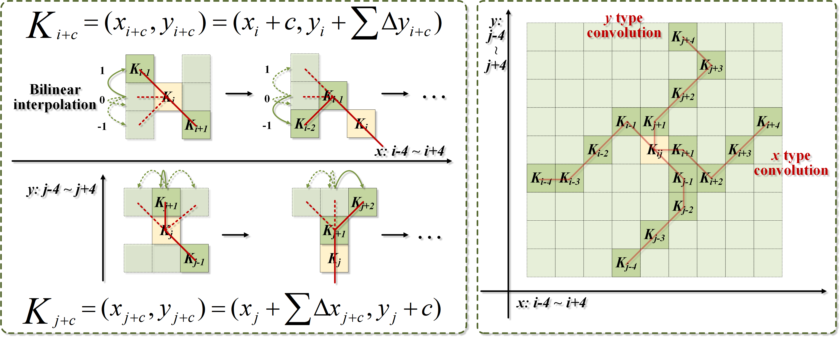
K_{ij}
K_{j+4}
K_{j+2}
K_{j+3}
K_{i-4}
K_{i-3}
K_{i-2}
K_{j+1}
K_{i+1}
K_{i+2}
K_{ij}
K_{i+4}
K_{i-1}
K_{j-1}
K_{i+3}
K_{j-2}
K_{j-3}
K_{j-4}

